Slide 1
Unlocking Stock Performance Insights
Radjamin Hukom
1/16/2025

Slide 2


Overview
Problem:
making educated decisions to invest is time-consuming and complex.
Proposed Solution:
Develop a data-driven framework to invest
This Photo by Unknown Author is licensed under CC BY-SA

Slide 3


Project Idea
Objective:
Identify key determinant financial ratios
Create a robust model to use for investment
Problem Solved:
Simplify investment analysis
This Photo by Unknown Author is licensed under CC BY-NC-ND
This Photo by Unknown Author is licensed under CC BY

Slide 4
Project plan
Gather Data
Explore and Clean the Data
Run the Models
Examine Problems
Attempt to Fix Problems

Slide 5

Dataset
Data Collection
Finsheet.io: Extracts financial statements, ratios, and key metrics.
Bloomberg: Provides real-time stock data and historical financial trends.
Programming & Tools
Google Colab (Python): Used for data preprocessing, model training, and visualization
Key Features:
S&P500 stocks + 1000 stocks from Russel 3000 index

Slide 6
On the Data
Rows = 1509 stock tickers
Columns = Ticker + Beta + 12 financial ratios * 5 years + % Price Change = 63
Problems:
Missing values
Outliers
Multicollinearity
Heteroscedasticity

Slide 7
Financial Ratios
Ratio | Meaning | E(sign)
Beta | Indicates the stock’s risk relative to the market | -
EPS | Shows profitability per share | +
ROE | Measures how efficiently equity generates profit | +
ROA | Reflects how effectively assets generate profit | +
Gross Margin | Reveals profitability after production costs | +
Operating Margin | Indicates how well operations generate profit before interest and taxes. | +
Net Profit Margin | Shows overall profitability after all expenses | +
Cash Ratio | Assesses short-term liquidity | +
Current Ratio | Measures short-term financial health | +
Quick Ratio | Evaluates liquidity without relying on inventory | +
Asset Turnover | Shows how efficiently assets generate revenue | +
Inventory Turnover | Reflects how quickly inventory is sold | +
Receivables Turnover | Measures how fast credit sales are collected | +

Slide 8
Machine learning models
Multiple Linear Regression (MLR): Establishes baseline relationships between variables.
Ridge & Lasso Regression: Enhances model stability by regularizing coefficients.
Elastic Net Regression (ENR): Balances Ridge and Lasso benefits for correlated predictors.
Support Vector Regression (SVR): Captures complex non-linear stock trends.
Random Forest Regression (RFR): Uses ensemble learning to improve accuracy.
Decision Tree Regression (DTR): Simple but prone to overfitting.
K-Nearest Neighbors Regression (KNNR): Predicts based on similar stock behaviors.
Weighted Least Squares (WLS) Regression: Handles heteroscedasticity in financial data.
Logit: Predicts positive or negative changes over 5-year period.

Slide 9
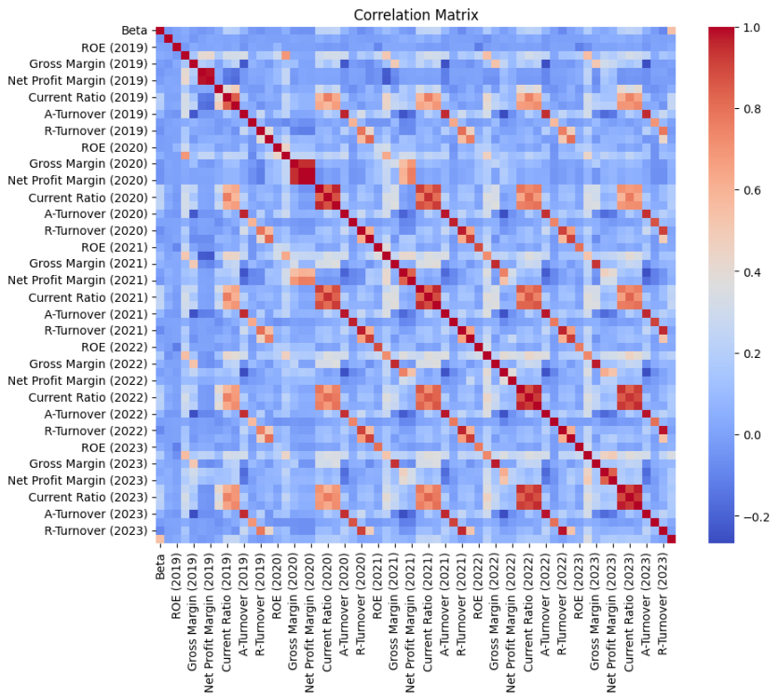
Important point:
There’s similar patterns over the years

Slide 10
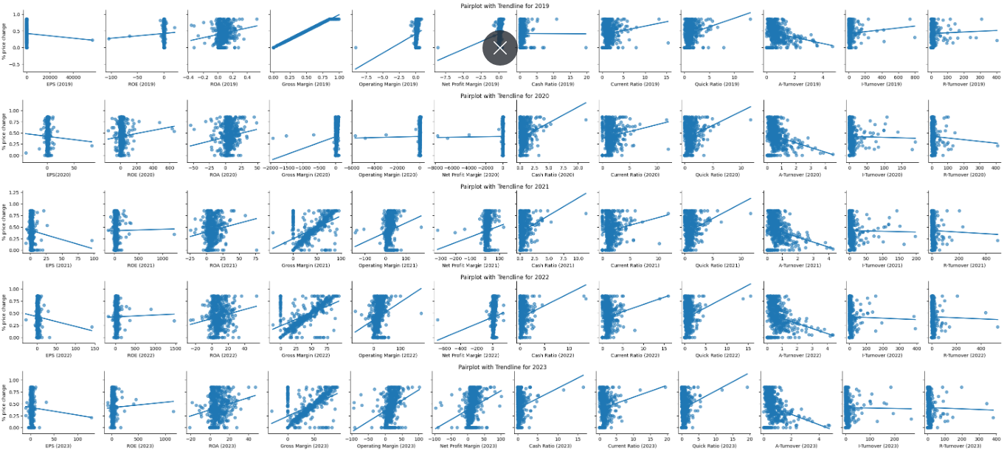

Slide 11
Ratios and % Price Change (Correlation)
Year | Ratio
2019 | Gross Margin***, Operating Margin, Net Profit Margin, Quick Ratio
2020 | Gross Margin**, Cash Ratio
2021 | Gross Margin**, Cash Ratio, Quick Ratio
2022 | Gross Margin**, Operating Margin
2023 | Gross Margin**, Operating Margin, Net Profit Margin

Slide 12
Ratios and % Price Change (Regression)
Year | <.05 | <.1
2019 | Gross Margin, Cash Ratio
2020 | ROA, Gross Margin, Current Ratio, Quick Ratio, A-Turnover | EPS, Net Profit Margin
2021 | Gross Margin Current Ratio, A-Turnover | EPS, Quick Ratio
2022 | Gross Margin, Operating Margin, Current Ratio, A-Turnover
2023 | Gross Margin, Operating Margin, Current Ratio, A-Turnover

Slide 13
Comparison of models
Models | Adjusted R-squared
Multiple Linear Regression | 1
Ridge Regression | .9990
Decision Tree Regression | 0.9989
Weighted Least Squares Regression | 1
Random Forest | 0.9992
Logit | .9663
Lasso | -0.0089
Elastic Net | -0.0089
SVR | -0.0090

Slide 14
Years Ranked by Adjusted R^2
2019: 0.996220
2022: 0.367828
2023: 0.350413
2021: 0.331874
2020: 0.241247

Slide 15

Initial Conclusions
Key takeaways:
2019 is by far the most accurate year to predict the 5-year stock price change
Focus on:
MLR (for baseline)
WLS (for heteroscedasticity)
Ridge (for multicollinearity)

Slide 16
NEW Variables
New Variables | Formula | Variance Inflation Factor
EPS | EPS | 1.001612
Gross Margin | Gross Margin | 1.030736
Returns | (ROA + ROE) /2 | 1.001706
Liquidity | (Cash + Quick + Current) Ratio /3 | 1.024700
Efficiency | (Asset + Inventory + Receivables) Turnover /3 | 1.005129

Slide 17
Is it robust? No!
Multicollinearity (intercorrelation among explanatory variables) is not like present.
Breusch-Pagan test for 2019:
P-value: 4.915320339106688e-106
White test for 2019:
P-value: 1.7970621043702633e-93
Heteroscedasticity (the variability of the response variable is unequal among the explanatory variables) is likely present.
Durbin-Watson statistic for 2019: 2.009556556490634 Autocorrelation (degree of correlation of response variable over time) is not likely present.

Slide 18

After trial & Error
Replace columns with the WLS-adjusted columns from the WLS model
Remove 'beta','EPS (2019)’
Test for BLuE
Check explanatory power

Slide 19
Robust, promising results
VIF values
Breusch-Pagan test for heteroscedasticity: P-value: 0.9466911602113062 No evidence of heteroscedasticity
Durbin-Watson test for autocorrelation: Durbin-Watson statistic: 2.000022615417361 No evidence of autocorrelation
Adjusted R-squared: 0.9999999999991485
Variables | VIF
Gross Margin (2019) | 1.136221
Returns (2019) | 1.017909
Liquidity (2019) | 1.132923
Efficiency (2019) | 1.041528

Slide 20
For the future
Check mix of stock tickers used (ensure there’s a fair amount of large, medium, and small companies)
Use more data (as we still only have ~1500 stock tickers)

Slide 21
Work cited
Bloomberg. (n.d.). Company profiles. Bloomberg. Retrieved from https://www.bloomberg.com
Finsheet. (n.d.). Financial data analysis tools. Finsheet. Retrieved from https://www.finsheet.io

